Slide 1
Intro to Machine Learning
钟俊勋、林俊凡、余伟江
2016.10.17

Slide 2
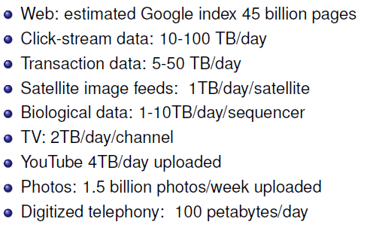
A Big Data Age！

Slide 3
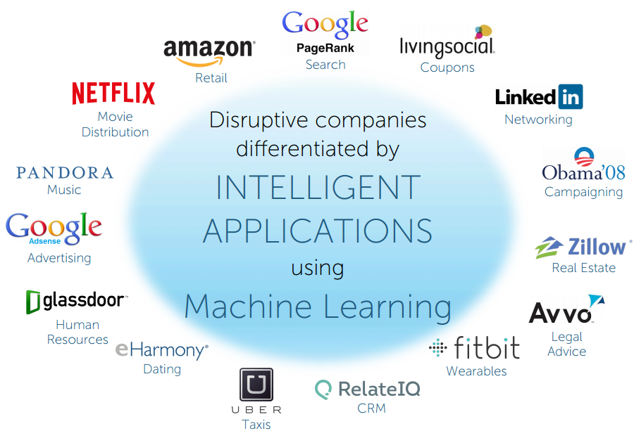

Slide 4
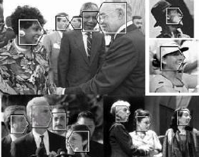

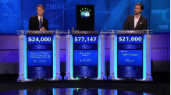

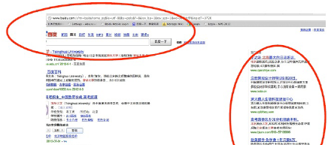
Machine Learning
Application：CV(计算机视觉)、Speech Recognition(语音识别)、Web Search & Recommendation(网络搜索和推荐系统)……
Definition：Wiki: “The design and development of algorithms that take as input empirical data and yield patterns or predictions that generated the data.”
Further more：Machine Learning seeks to develop theories, methods and computer systems for representing, classifying, clustering and recognizing, predicting and more.
Machine Learning is the science of making computer artifacts improve their performance with respect to a certain performance criterion using example data or past experience, without requiring humans to program their behavior explicitly.

Slide 5
Machine Learning
When Machine Learning is Necessary:
Human expertise is too expensive
Human expertise does not exist
(e.g., navigating on Mars)
Humans cannot explain their expertise
(e.g., speech recognition)
Problem (and hence solution) changes over time
(e.g., network routing)
Solution needs to be adapted to particular cases
(e.g., user biometrics for intelligent/adaptive user interface)

Slide 6
Machine Learning
some important elements
Task:
Classiﬁcation? Clustering? Topic extraction? Embedding?
Data and other info:
Input and output (e.g., continuous, binary, counts, ...)
Supervised or unsupervised, of a blend of everything?
Prior knowledge? Bias?
Models and paradigms:
MRF? Regression? SVM? BN?
Bayesian/Frequents ? Parametric/Nonparametric?
Objective/Loss function:
MLE? MCLE? Max margin?
Log loss, hinge loss, square loss?
Tractability and exactness trade off:
Exact inference? MCMC? Variational? Gradient? Greedy search?
Online? Batch? Distributed?
Evaluation:
Visualization? Human interpretability? Predictive accuracy?

Slide 7
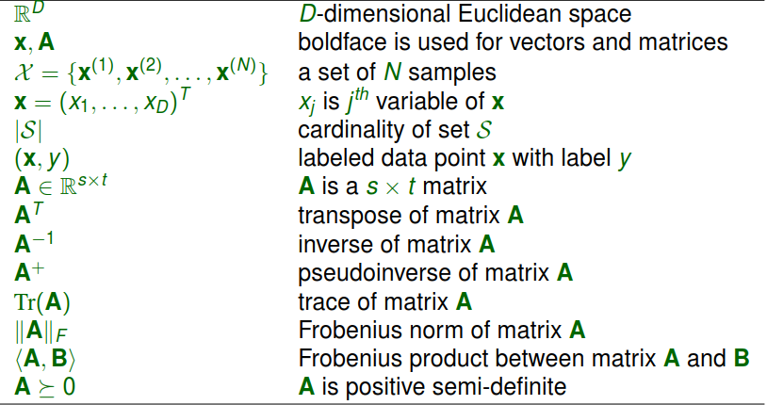
Machine Learning

Slide 8
Methods in Machine Learning
Traditional Methods：
Supervised Learning
Unsupervised Learning
Reinforcement Learning
Recent Learning Methods:
Semi-supervised Learning
Transfer Learning & Multi-task Learning
Active Learning
Learning Strategies:
Generative & Discriminative Learning（www.cnblogs.com/fanyabo/p/4067295.html）
Parametric & Non-Parametric Learning
Nonparametric Bayesian Methods

Slide 9
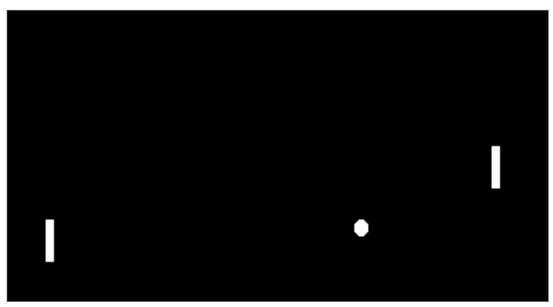
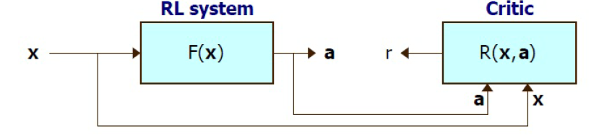
Reinforcement Learning
Learning a policy (a sequence of actions) via a trial-and-error process (exploration vs. exploitation)
No supervised output but delayed reward
Examples of applications:
Game playing
Robot navigation in search of goal location
Some challenging issues:
Multiple agents
Partial observability of states

Slide 10
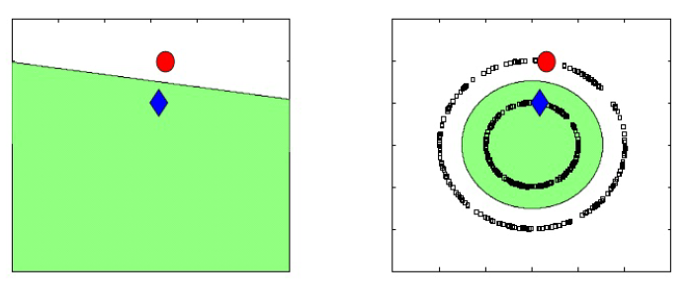
Semi-Supervised Learning
Semi-supervised learning (SSL) is halfway between supervised and unsupervised learning.
Supervision information is available for some, but not all, training instances.
To utilized, the distribution of unlabeled data is necessary to satisfy some key assumption.

Slide 11
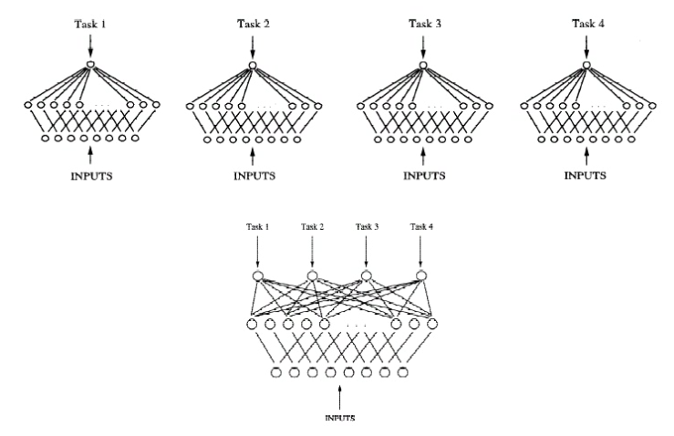
Transfer Learning & Multi-task Learning
Transfer Learning（迁移学习）：Source tasks learned previously can help the learning of target task(s)
Transfer of knowledge from a dissimilar task can degrade performance.
Multi-task Learning：Multiple tasks are typically learned simultaneously to leverage the labeled data from similar tasks

Slide 12
Transfer Learning & Multi-task Learning
Multi-task: Different tasks may share:
The same representation
The same model parameters
The same distribution for the model parameters
The same cluster in some clustering structure

Slide 13
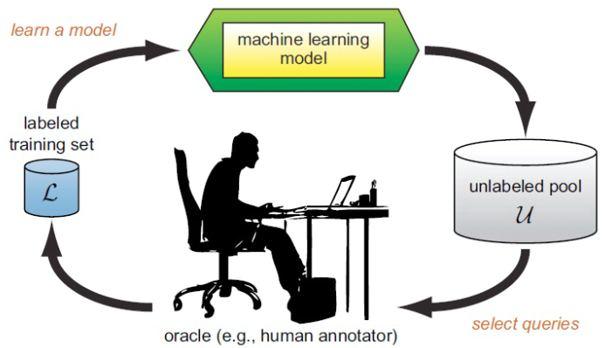
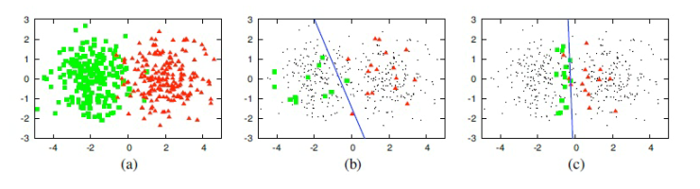
Active Learning
Active learning is well motivated in many applications in which unlabeled data may be abundant but labels are difﬁcult, time-consuming or expensive to obtain

Slide 14
Strategies in Machine Learning
Generative Learning(生成式)：
Assume some functional form for P (x |y ), P (y ). This is a “generative” model of the data.
Estimate parameters of P (x |y ), P (y ) directly from training data.
Use Bayes rule to calculate P (y |x )
Discriminative Learning(判别式)：
Directly assume some function form for P (y |x ).This is a “discriminative” model of the data.
Estimate parameters of P (y |x ) directly from training data.

Slide 15
Parametric & Nonparametric
Parametric:
Data distribution follows a parametric model, e.g., Gaussian.
The number of parameters is independent of the sample size |X |.
Semiparametric:
Data distribution is represented by a small number of local parametric models.
Nonparametric:
The data speaks for itself.
A nonparametric model is associated with an inﬁnite set of parameters.
The number of stuff we need to keep to represent the hypothesis grows linearly with the size of the training set.
The model ﬂexibility increases (and hence the model bias decreases) from parametric to semiparametric to nonparametric methods

Slide 16
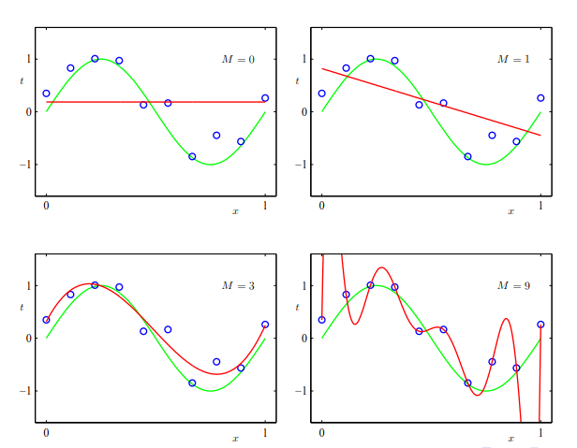

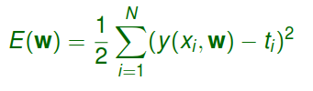

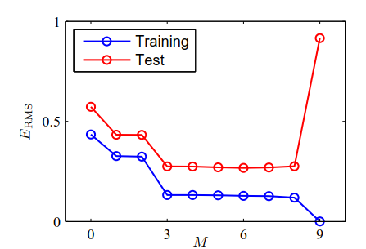
An Example:
Polynomial function for ﬁtting data
Loss：
RMS：

Slide 17
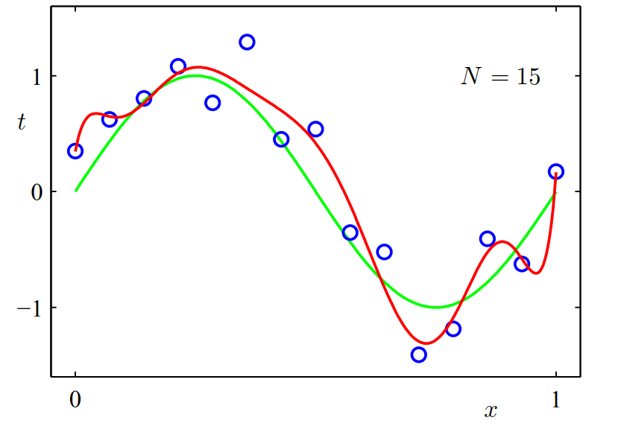
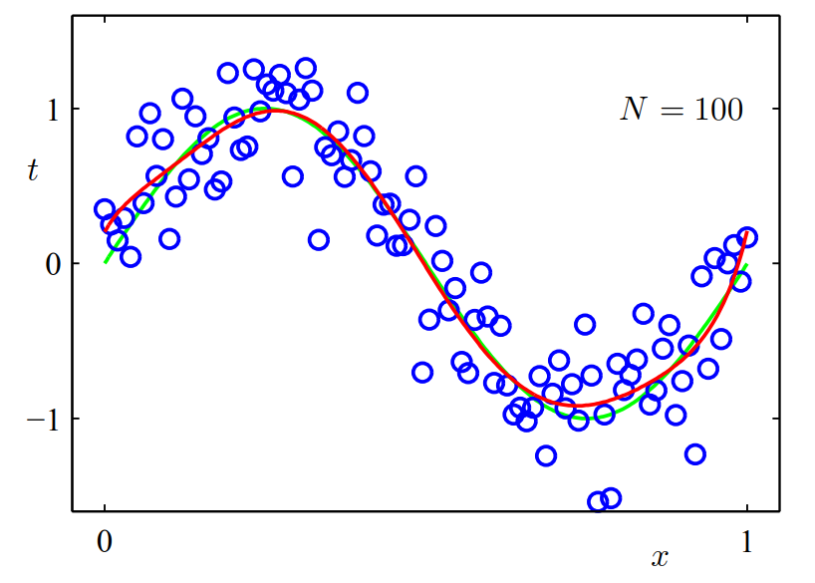
An Example

Slide 18
Overfit
Why separate training and testing?
training error is usually unrealistic low (overﬁtting)
error on test data (data not used to ﬁt model) is more realistic
Model complexity:
more complex model: smaller training error but larger difference between test and training error
less complex model: larger training error but smaller difference between test and training error

Slide 19
Loss
Training Loss：Loss in training data
Generalization Loss: Loss in the whole sample space(usually unable to get).
Test Loss： Loss in test data(clean）
Since generalization error is usually unreachable，we use test error approximate the generalization Error。

Slide 20
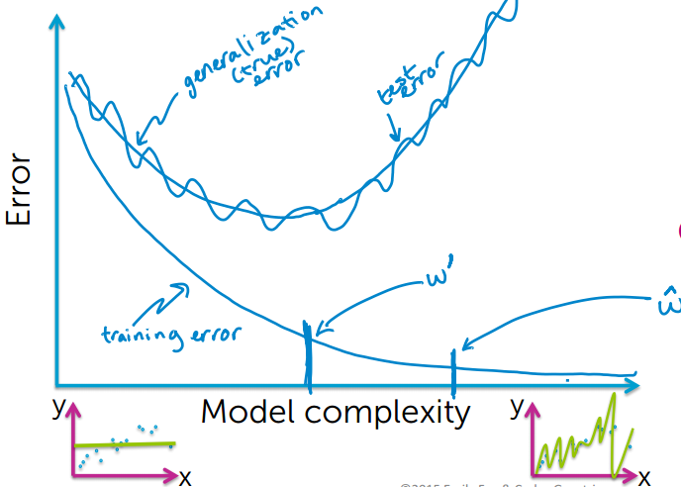
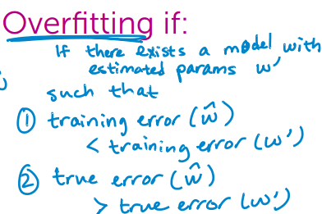
Relation Between Them

Slide 21
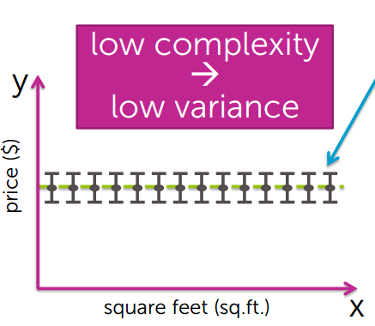
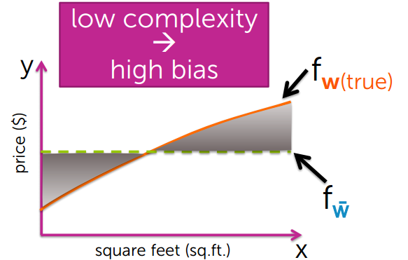
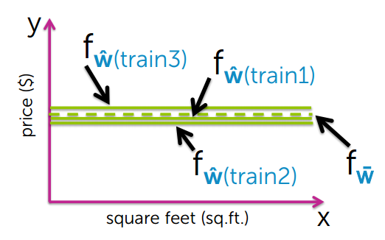
Composition of Generalization Loss
Noise(噪声，不可避免的误差，比如测量仪器的精度误差等等)
Variance(方差，在同分布数据集中模型族在不同训练集中模型的区别程度)
Bias(偏移，在同分布的数据集中模型族的平均误差，只与模型相关)

Slide 22
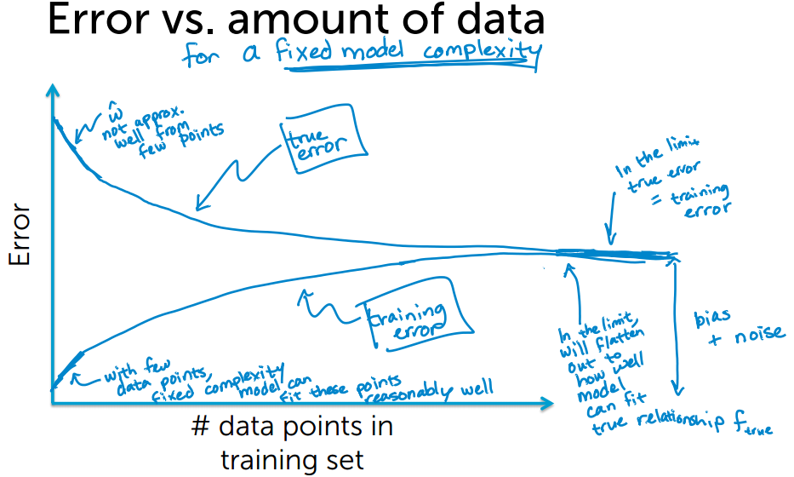
Bias is unrelated to Data

Slide 23
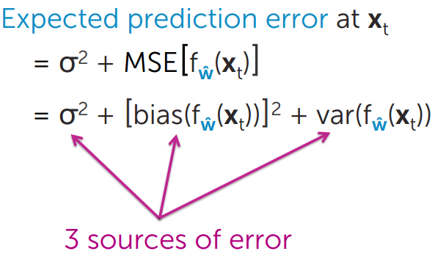
Analysis Loss in Perspective of Probability

Slide 24
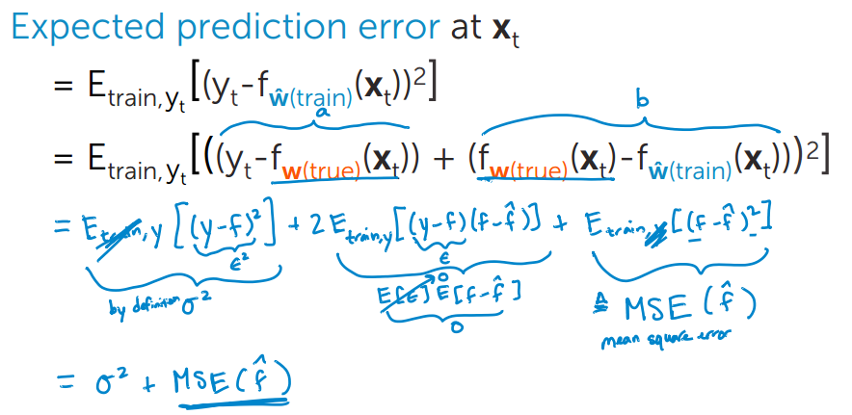
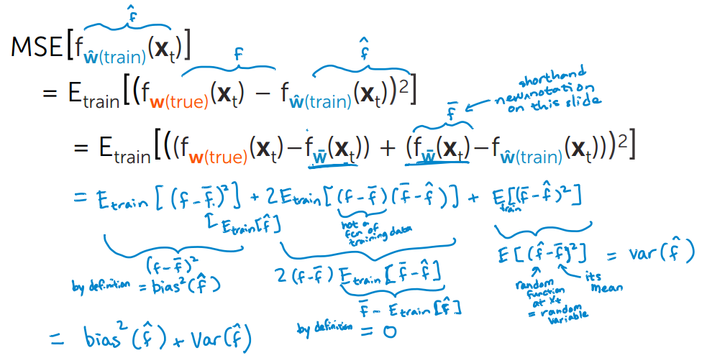

Slide 25
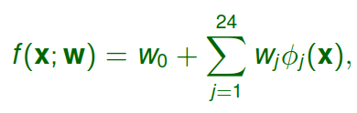
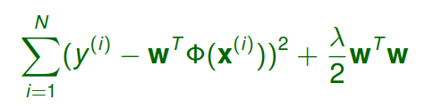
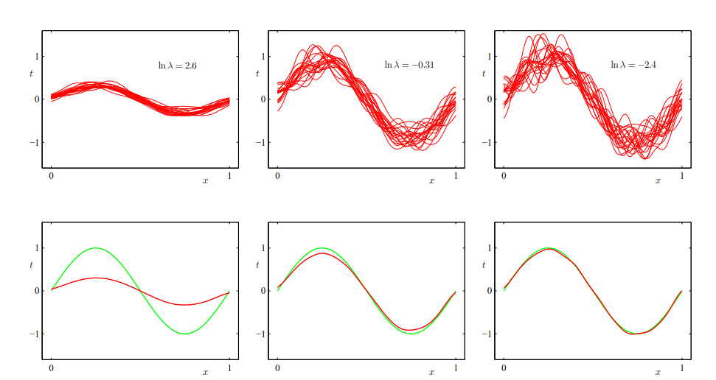
Bias-Variance Tradeoff

Slide 26
Bias-Variance Trade-off
The model with the optimal predictive capability is the one that leads to the best balance between bias and variance.
Bias-variance decomposition has limited practical value
Bias and variance cannot be computed since it relies on knowing the true distribution of x and y (and hence h(x) = E[y |x]).
Bias-variance decomposition is based on averages with respect to ensembles of data sets, whereas in practice we have only the single observed data set.

Slide 27
Regularization
Model complexity: the difference between training and test error
Generalization: the ability to categorize correctly new samples that differ from those used for training
Regularization allows complex models to be trained on data sets of limited size without severe oveﬁtting, by limiting the effective model complexity
Benefits：
statistical: robust to large number of features
numerical: stabilize solution

Slide 28
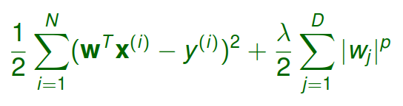
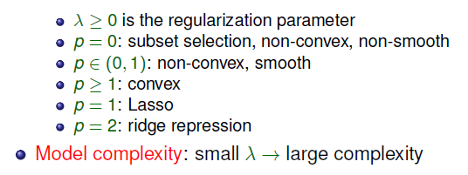
Regularization

Slide 29
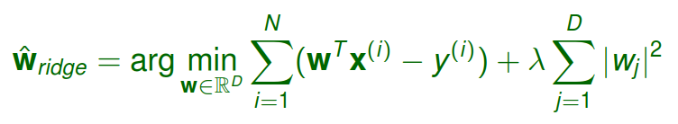


Ridge Regularization
Ridge Regression：
Implicit dimension reduction
More stable (smaller weight) than least squares
It does not generally lead to sparse solution.
Solution：
standard least square regression solution：
Advantage: ridge regression allows D > N
stable: XXT + λI is always invertible
implicit dimension reduction

Slide 30
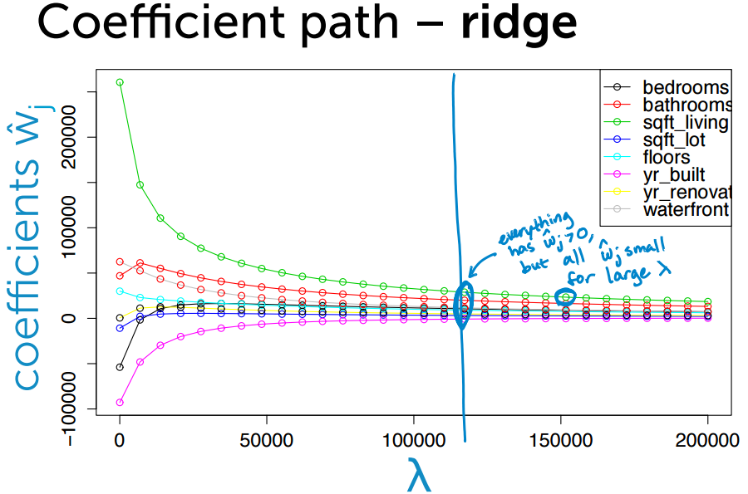
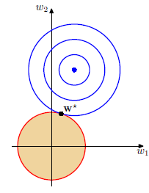

Slide 31
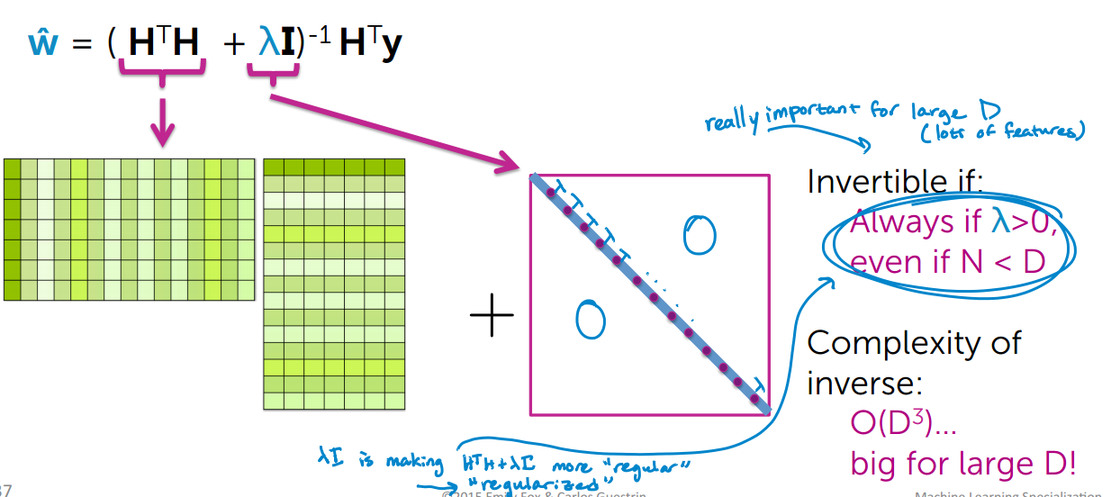

Slide 32
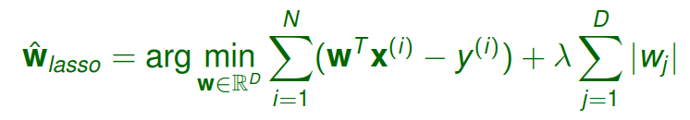
Lasso Regression
Lasso：
Convex optimization problem, but solution may not be unique
Global solution can be efﬁciently found
Solution is sparse, achieving feature selection.
Solutionis not necessarily stable.
Limitation of lasso: the number of selected variables by the lasso is limited by the number of observations N

Slide 33
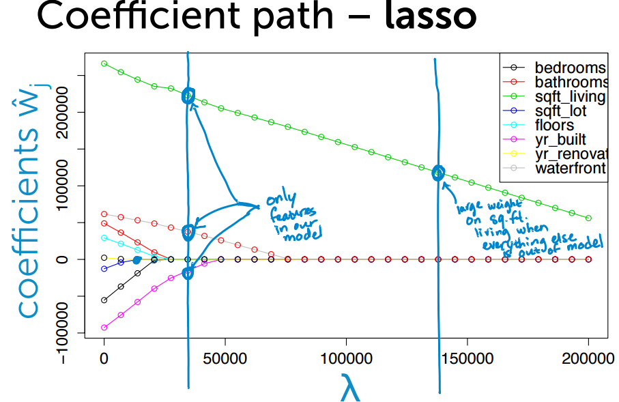
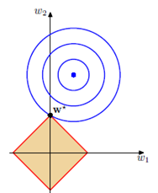

Slide 34
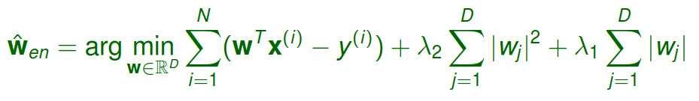
Regularization
Elastic net：
Elastic net has grouping effect, i.e., it tends to select a group of highly correlated variables once one variable among them is selected
Lasso tends to select only one out of the grouped variables and does not care which one is in the ﬁnal model

Slide 35


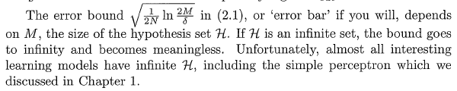
Hoeffding Inequality
可以通过VC Dimension来确定M的上界

Slide 36
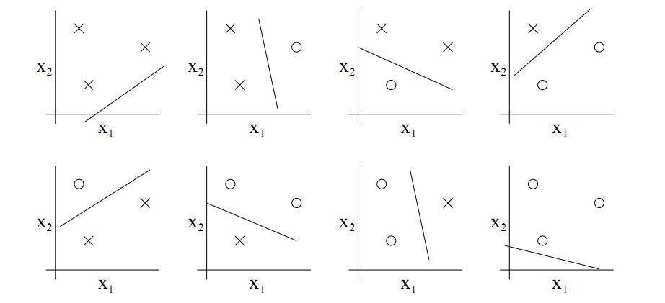
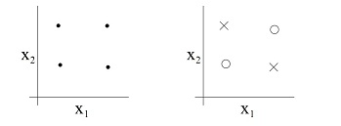
VC Dimension
VC Dimension：VC(H) is the size of the largest data set that can be shattered by H
Shattering: A function class H is said to shatter a set of data points (x(1) , . . . , x(N ) ) if H can realize any labeling on this data set

Slide 37
Other Method to Reduce Overfiting
Cross Validation：split training set D into training set and validation set.（waste training data）
k -fold cross validation：bias variance tradeoff
Feature Selection：Given labeled data, we compute some scores that measures how informative each feature is about the class label
Ranking criteria：互信息、贝叶斯误差、信息冗余
Feature select schemes:
ﬁlter: direct feature ranking
wrapper: determine the features based on performance under the learning algorithms to be used.
simultaneous learning and feature selection. E.g., lasso, Bayesian feature selection, etc.

Slide 38
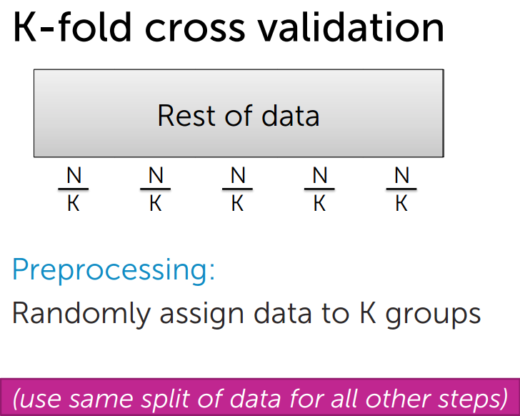
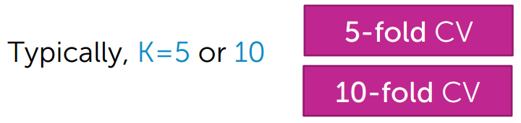
Cross Validation

Slide 39

Frequentist vs. Bayesian
Frequentist: The parameters are constant-valued but unknown.
Bayesian: The parameters are random variables whose values are unknown.
In practice, Bayesian MAP estimate is less susceptible to overﬁtting than the ML estimate of the parameters, which also automatically determines model complexity using training data alone
Bayesian model selection is used when there exists prior knowledge about the appropriate class of approximating functions, represented as a prior distribution over models, p(model)

Slide 40
Bayesian Model Selection
From the posterior distribution, we may:
choose the model with the highest posterior probability, or
choose multiple models with high posterior probabilities, or
use all models weighted by their posterior probabilities.
Regularization may be seen as a Bayesian approach in which the prior favors simpler models.

